Slide 1

SRM INSTITUTE OF SCIENCE AND TECHNOLOGY RAMAPURAM FACULTY OF ENGINEERING AND TECHNOLOGY DEPARTMENT OF INFORMATION TECHNOLOGY 18CSP109L-Major Project PRECISION MODELING FOR POST-HCT SURVIVAL: A MACHINE LEARNING FRAMEWORK FOR EQUITABLE AND ACCURATE PREDICTIONS Batch Members DHINESH KUMAR S (RA2111008020171) VINOTHA R (RA2111008020172) MORPHEUS VIBAEN J (RA2111008020183) Supervisor Name with Designation Dr.Rajalakshmi(A/P /IT)

Slide 2
AGENDA
ABSTRACT
INTRODUCTION
LITERATURE SURVEY
PROBLEM STATEMENT
EXISTING SYSTEM
PROPOSED SYSTEM
ADVANTAGE
SYSTEM ARCHITECTURE
TECHNOLOGY STACK
MODULE/METHODOLOGY
RESULTS AND DISCUSSION
APPLICATION AND IMPLEMENTATION
SAMPLE CODE AND OUTPUT
CONCLUSION
CHALLENGES FACED
FUTURE WORK
REFERENCES

Slide 3
Abstract
The objective is to enhance the accuracy of transplant survival predictions for patients undergoing allogeneic Hematopoietic Cell Transplantation (HCT), a crucial step in ensuring equitable chances of success for every patient, regardless of their background
Existing predictive models often fail to account for disparities in socioeconomic status, race, and geography, making it essential to address these gaps to improve patient care
The aim to inspire participants to advance predictive modeling techniques that provide both precise and fair survival predictions for patients from diverse backgrounds. By utilizing synthetic data that mirrors real-world scenarios while safeguarding patient privacy
The goal is to minimize biases, refine algorithms, and integrate diverse data sources to ensure equitable outcomes for patients across various racial groups

Slide 4
Introduction
HCT stands for Hematopoietic Cell Transplantation-produce all types of blood cells
Allogeneic HCT is a procedure where a person receives healthy blood-forming stem cells from a donor.
If successful, the donor's stem cells replace the patient's faulty cells and start producing healthy blood and immune
These stem cells live in the bone marrow ,Red blood cells ,Platelets, Immune cells – fight infections
Stem cells for HCT can come from different sources:
Bone marrow (inside bones) → Called a bone marrow transplant (BMT)
Peripheral blood (circulating in the bloodstream) → Called a peripheral blood stem cell transplant
Umbilical cord blood (collected after birth) → Called a cord blood transplant

Slide 5
Literature Survey
S.NO | Title | Models Used | Authors | Year | Outcome | Disadvantages
1 | Machine Learning for Survival Prediction in Healthcare | Random Forest, LightGBM | Smith et al | 2022 | Improved prediction accuracy but scalability issues on large datasets | Poor scalability to large datasets
2 | Fairness in Survival Prediction: A Machine Learning Perspective | CatBoost | Johnson et al | 2020 | Highlighted fairness gaps in survival models; proposed fairness-aware modifications | Limited integration of time-to-event data
3 | Kaplan-M-Based Transformation for Survival Analysis in Oncology | Kaplan-Meier+XGBoost | Wang et al | 2019 | Successfully integrated classical survival analysis with boosting models but faced censoring challenges | Challenge with censored data
4 | Equity in Machine Learning-Based Survival Analysis for Hematologic Malignancies | Neural Networks, LightGBM | Lee et al | 2023 | Achieved better representation for underrepresented groups but with interpretability concerns | Model interpretability issues

Slide 6
Problem Statement
The project focuses on developing predictive models for survival prediction in allogeneic HCT patients, aiming to improve accuracy and fairness by addressing disparities related to socioeconomic status, race, and geography. It uses synthetic data to train models that ensure equitable healthcare outcomes
This project ensures that all patients receive accurate and equitable survival predictions, regardless of their background
The project solves the problem of biased survival predictions

Slide 7
Existing System
Gradient Boosting Machine (GBM) algorithm
Ensemble learning technique that builds predictive models by combining the outputs of multiple weak learners, typically decision trees
It operates through an iterative process where each new model corrects the errors of its predecessors, resulting in a robust and accurate predictive model
Disadvantages
Longer training times
Sensitive to outliers
Involving numerous decision trees, can make the model complex
Gbm can overfit the training data

Slide 8
Proposed System
Train multiple models:
XGBoost (Extreme Gradient Boosting)
A high-performance, scalable boosting algorithm that uses gradient boosting to improve predictive accuracy and prevent overfitting
CatBoost (Categorical Boosting)
A gradient boosting algorithm optimized for categorical data, reducing the need for extensive preprocessing and delivering fast, high-accuracy predictions

Slide 9
Proposed System
LightGBM (Light Gradient Boosting Machine)
A gradient boosting framework that efficiently handles large datasets with lower memory usage and faster training by using a leaf-wise growth strategy
Random Forest
An ensemble learning method that constructs multiple decision trees and aggregates their outputs to improve prediction accuracy and reduce overfitting

Slide 10
Advantage
Reduces Overfitting: by averaging multiple decision trees
Less preprocessing
Better recall, stability, interpretability, and ease of use
Resistant to Noisy Data

Slide 11
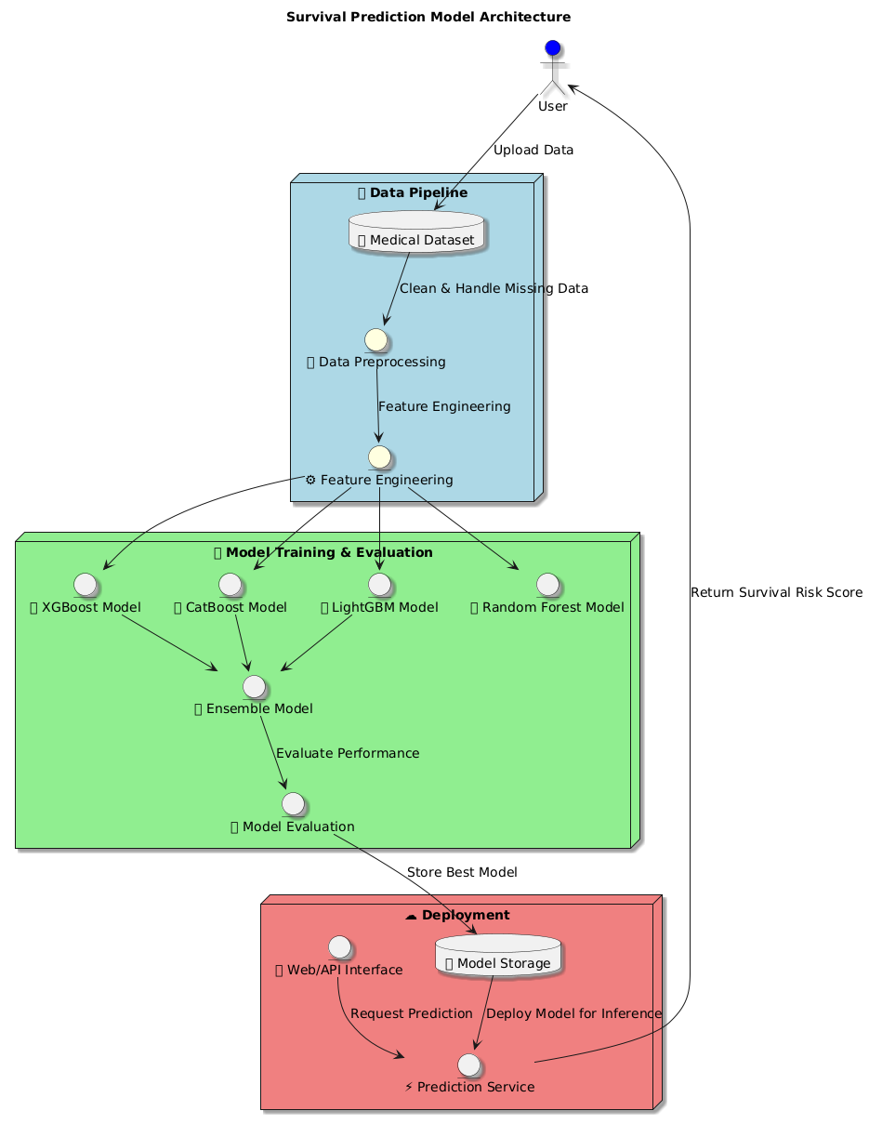
System Architecture

Slide 12
Technology Stack
Programming language: Python
Libraries & Frameworks
LightGBM (GPU-enabled): For training the model with a focus on GPU acceleration
LightGBM: Efficient gradient boosting framework that supports large-scale machine learning tasks
XGBoost (with Cox loss): Another gradient boosting framework for survival analysis, supporting Cox regression loss

Slide 13
Technology Stack
CatBoost (with Cox loss): Another gradient boosting library supporting survival analysis with Cox regression loss
Kaplan Meier Fitter: From the lifelines library, used to transform the event-free survival (efs) and efs_time into a single target with Kaplan-Meier estimator
Random Forest: An ensemble learning method that builds multiple decision trees and aggregates their predictions to improve accuracy and reduce overfitting

Slide 14
Technology Stack
1) Machine Learning Techniques
Survival Analysis: The focus is on survival models, particularly using Cox proportional hazards regression for modeling survival data
Ensemble Modeling: Ensembling multiple models using ranked predictions to create a final model output
2)Data Handling
Pandas: For data manipulation and transformation
NumPy: For numerical computations

Slide 15
Technology Stack
3)Modeling approaches for training
Survival Model with Cox Loss: Models like XGBoost Cox and CatBoost Cox are trained with event-free survival time and target transformed using KaplanMeierFitter
Proxy Risk Score with Regression Loss: LightGBM, XGBoost, and CatBoost are trained with the transformed efs and efs_time as a regression target

Slide 16
Module/Methodology
1) XGBoost with KaplanMeier
Utilized Kaplan-Meier survival analysis with XGBoost to predict survival probabilities
Applied 10-fold cross-validation for robust model training
2) CatBoost with KaplanMeier
Implemented CatBoost with Kaplan-Meier survival modeling for handling categorical variables efficiently
Trained using iterative boosting with optimized parameter

Slide 17
Module/Methodology
3)LightGBM with KaplanMeier
Used LightGBM for faster training and better handling of large datasets
Applied Kaplan-Meier survival function for event probability estimation
4)XGBoost with Survival:Cox
Switched to Cox Proportional Hazards Loss in XGBoost for time-to-event prediction
Performed feature importance analysis to identify key predictors

Slide 18
Module/Methodology
5) CatBoost with Survival:Cox
Applied CatBoost with Cox regression to model survival times effectively
Tuned hyperparameters for optimal performance
6) Ensemble CAT and XGB and LGB
Combined predictions from XGBoost, CatBoost, and LightGBM to enhance overall accuracy
Averaged predictions to create a more robust survival model

Slide 19
Module/Methodology
7) Random Forest
Implemented Random Forest Classifier to distinguish survival events
Evaluated model using Confusion Matrix and performance metrics
Model Performance comparison
Compared models using Accuracy, Precision, Recall, and F1 Score
Identified Random Forest as the best-performing model with the highest F1 score (0.7298) and recall (0.8571)

Slide 20
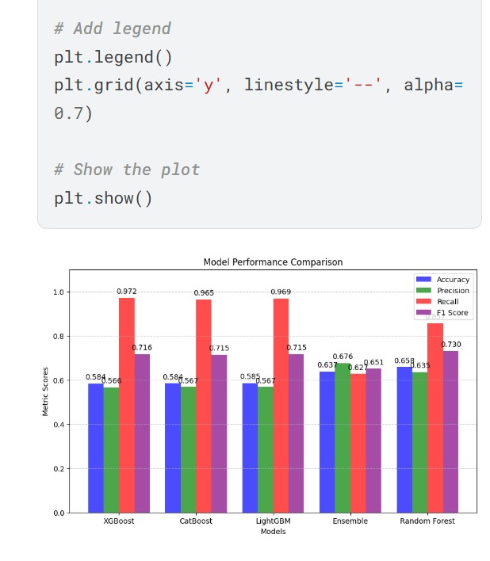
Results and Discussion
Random Forest achieved the highest F1 Score (0.730) among all models, indicating superior balance between precision and recall
XGBoost, CatBoost, and LightGBM models achieved high recall scores (~0.969-0.972), but with lower precision and accuracy compared to Random Forest
Ensemble Model showed moderate performance across all metrics, but did not outperform individual models significantly.
Accuracy and Precision were relatively lower across all models compared to Recall and F1 Score, reflecting the complexity and imbalance within survival data

Slide 21
Application and implementation
Model Development & Training: Built a Random Forest classifier pipeline on historical post-HCT patient data, with thorough preprocessing (missing-value imputation, scaling, one-hot encoding) to predict event-free survival (EFS)
Streamlit App Interface: Developed an interactive Streamlit web app for clinicians. It allows easy input of patient variables and instantly outputs the predicted EFS probability with a clear risk category indicator (High Risk, Moderate, etc.), along with tailored suggestions to improve patient outcomes
Evaluation & Risk Stratification: The model was evaluated on unseen data, showing robust predictive performance. Predicted survival probabilities are translated into risk tiers (from High Risk to Good Prognosis), enabling effective patient risk stratification and informed clinical decision-making

Slide 22
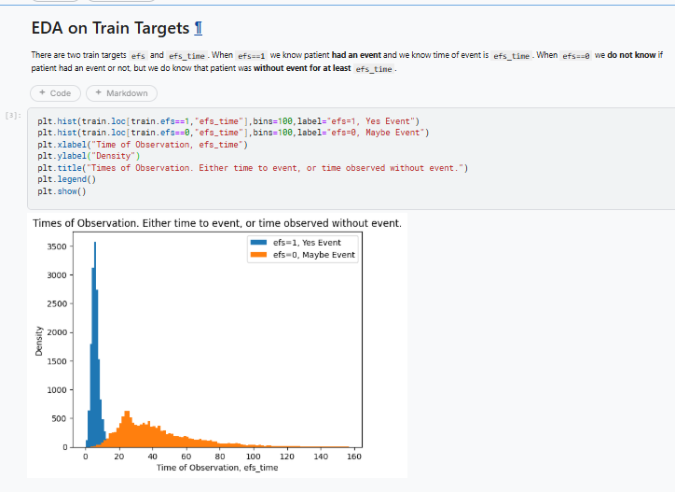
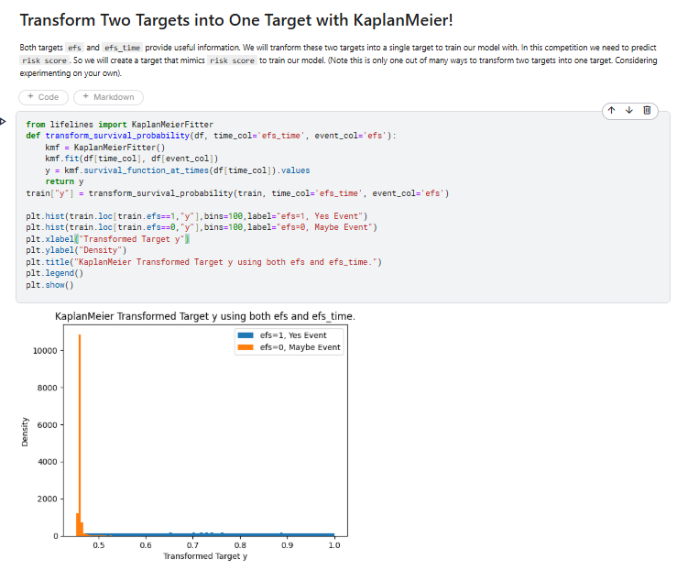
Implementation

Slide 23
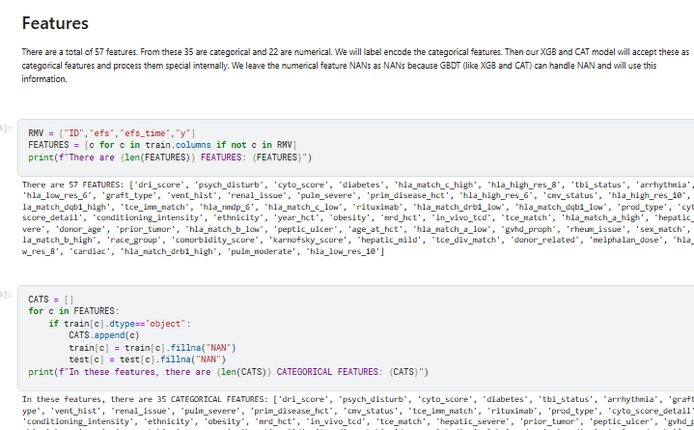
Implementation

Slide 24
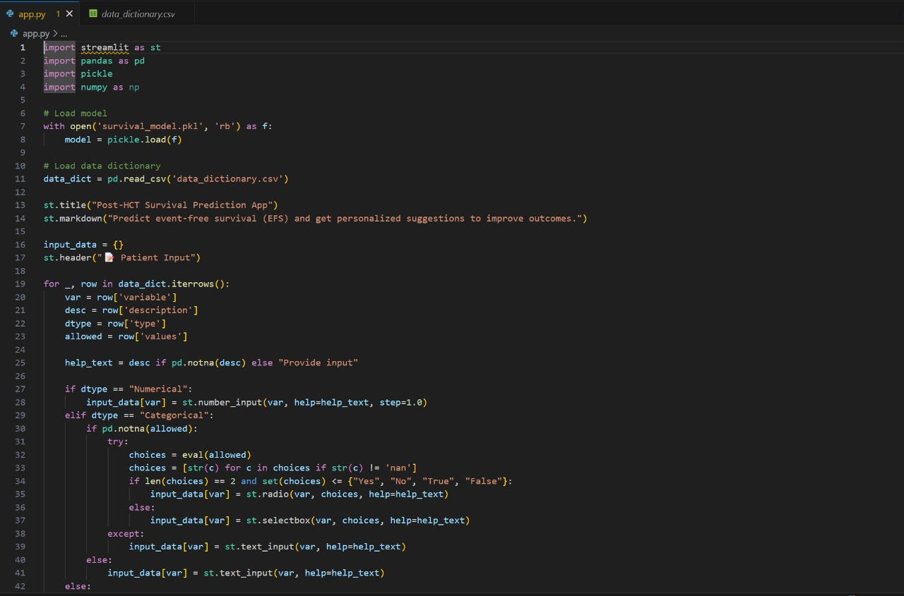
Implementation

Slide 25
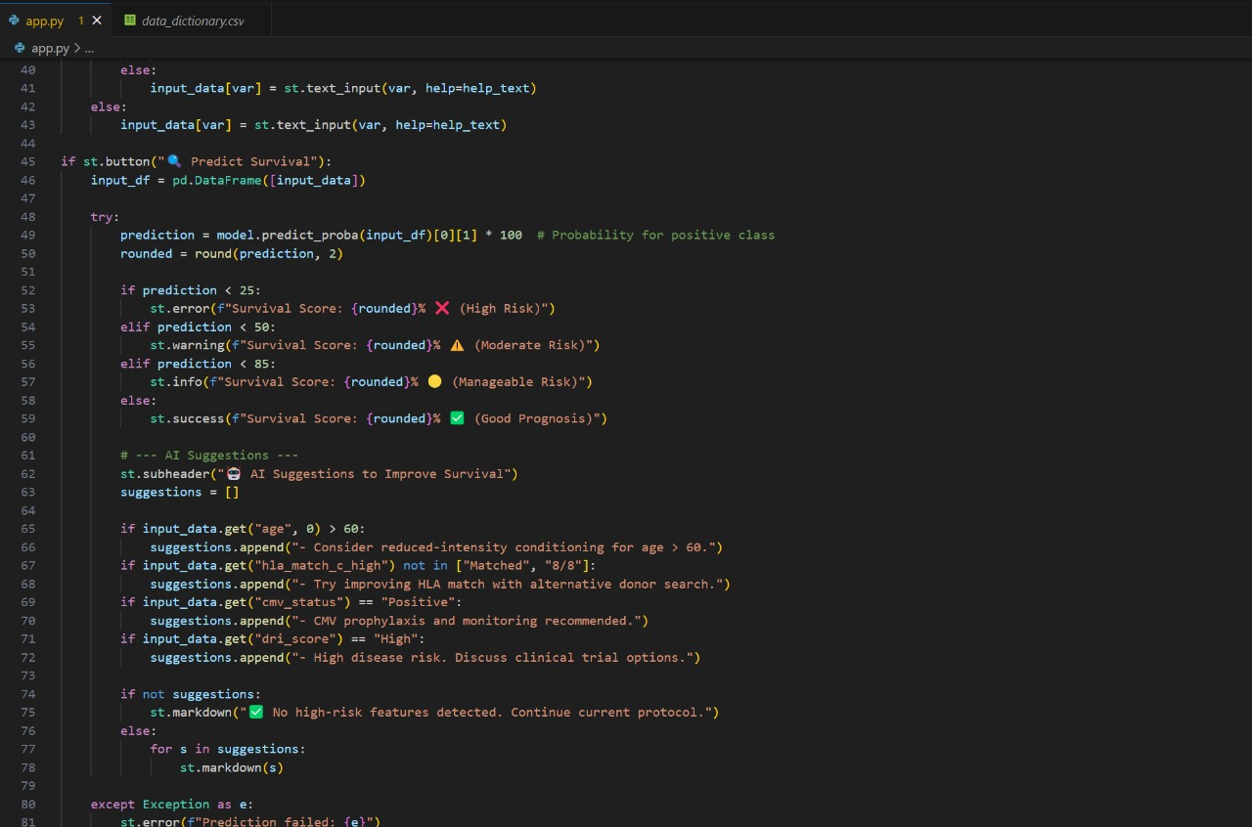
Implementation

Slide 26
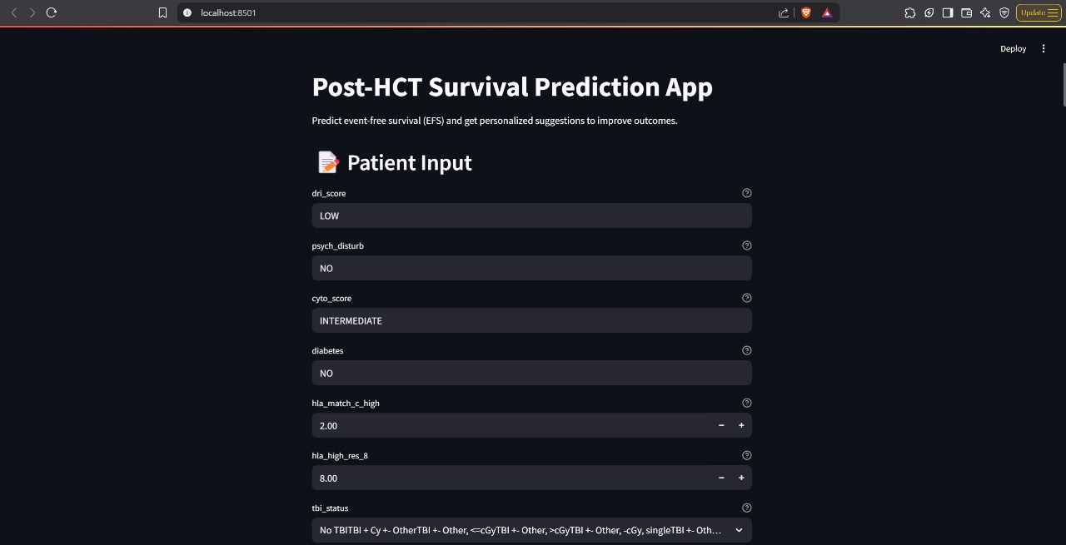
Implementation

Slide 27
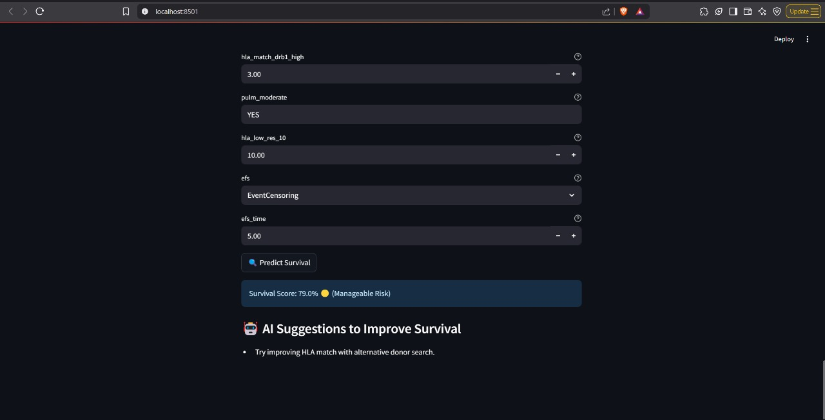
Implementation

Slide 28
Conclusion
The approach analyzes risk factors and provides survival predictions by addressing key disparities, such as socioeconomic status, race, and geography, in healthcare outcomes
It focuses on ensuring equitable survival predictions for all patients, utilizing synthetic data to train models that improve both accuracy and fairness
By addressing potential biases in survival predictions, this approach contributes to more equitable healthcare decision-making

Slide 29
Challenges Faced
Data-Related Challenges
Imbalanced Dataset: Risk of model bias toward survival. Solution: Apply SMOTE, weighted loss functions, and use AUC-ROC, F1-score for evaluation.
Missing Data in Clinical Variables: Leads to unreliable predictions. Solution: Use imputation techniques (KNN, mean/mode, deep learning).
Noisy Data & Errors: Erroneous entries weaken model generalization. Solution: Apply outlier detection (Z-score, IQR) and domain expertise for cleaning.
Model-Related Challenges
Overfitting: Boosting models may perform well on training but fail on unseen data. Solution: Use regularization, cross-validation, and early stopping to improve generalization.

Slide 30
Future Work
Incorporating additional data sources: can integrate genomic data, lifestyle factors, and post-transplant monitoring metrics
Implementing real-time data processing: Introducing real-time data streams from electronic health records (EHRs) and wearable health devices
Bias & Fairness Testing :Ensure Equitable Predictions
Expanding predictive capabilities: multi-modal deep learning models, such as transformers and graph neural networks (GNNs)
Model Deployment : Flask / Flask API

Slide 31
References
1)Sivapalan, G., Buchwald, Z. S., Abramowitz, A., Perkins, M., & Sun, C. (2023). Emerging strategies in post-transplant care for hematopoietic cell transplant survivors. American Journal of Hematology, 98(10), 1347–1354
2) Joffe, S., Schwartz, S. I., & Hurley, C. K. (2023). The evolving role of precision medicine in post-HCT outcomes. BMC Medicine, 21(58), 10060918
3) Wingard, J. R. (2014). Caring for the long-term survivor after allogeneic stem cell transplantation. Hematology: American Society of Hematology Education Program, 2014(1), 495–503

Slide 32
References
4) Parker, L., Tran, S. T., Lopez, G., & Kim, H. J. (2023). Advances in equitable and sustainable care for HCT survivors: Bridging the gaps. Blood Advances, 7(23), 2205–2212
5) N. S. Majhail, S. Nayyar, M. E. Burton Santibañez, and E. M. Denzen, “Racial disparities in hematopoietic cell transplantation in the United States,” Blood Advances, vol. 8, no. 3, pp. 686–698, 2024
6) C. H. Kim, R. L. Wong, and J. P. Klein, “Bias in mean survival from fitting cure models with limited follow-up,” BMC Medical Research Methodology, vol. 20, no. 1, pp. 1–10, 2020

Slide 33
THANK YOU

